Slide 1
Future Directions of Academic Libraries in Data Curation
Presenter: Hui Lyu
Graduate Student of University of Illinois at Urbana-Champaign

Slide 3
Introduction

Slide 4

Background
Academic research mainly rely on digital materials and documents.
However, the large amount of intellectual output is usually unorganized and cannot be collected and preserved for a long time.
To solve this problem, libraries are the institutions that could best help researchers to disseminate, preserve and manage those data systematically, and to offer data curation service (Heidorn, 2011).
Challenge of academic libraries:
There still exists large space of technical and administrative improvement for academic libraries (Choudhury, 2008).

Slide 5
Digital preservation and data curation
Digital Preservation
Storage of data
Ability to reproduce data
Precondition of data curation
Data Curation
Accessible and reusable throughout lifecycle
Encompass digital preservation

Slide 6
Existing Problems

Slide 7
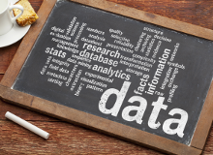
Issues of academic libraries
Data management system is not well-designed to preserve intellectual outputs of vulnerable copies.
Research data can not be permanently preserved under unstable backup programs.
Metadata and embargoed files are not intelligently connected to the PDF files with immature policies.
The relationship between researchers and librarians are not well-established to implement data curation.

Slide 8
Current Measures

Slide 9
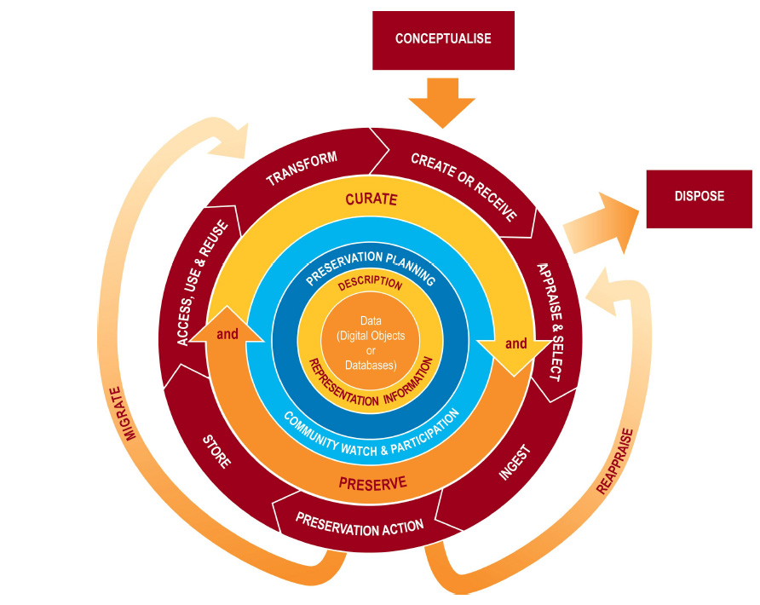
Digital Curation Centre Lifecycle Model
DCC Lifecycle Model was proposed by Higgins in 2008
The DCC Model consists of two parts.
The inner rings are full-cycle activities made by data curators in the libraries.
The outer rings are sequential actions which need the collaboration between both librarians and researchers.

Slide 10
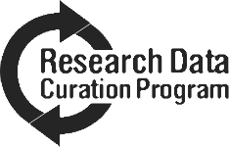
Institutional Repositories （IR）
Current research of IR focuses on:
Providing long-term digital preservation.
Developing new roles and relationships between libraries and academic communities through the training of “data scientists” or “data humanists”.
Engaging faculty in discussions about the value of IR services to the current scholarly publishing system.
Making IR an important component in data curation.
A university-based IR
Of the members
For the members
UC San Diego Library’s Research Data Curation Program

Slide 11
Future Directions

Slide 12
Collaboration
&
Integration
Permanent
Preservation
Security and Sharing
Value-added
Information
Data Quality
Framework
Five aspects

Slide 13

Central aspects
Collaboration & Integration
Between repositories and organizations of academic community
Between data curators and scientists or researchers
Integration of documentation, metadata and valuable context in the data management system
Communications of interdisciplinary research
Data curation is not only a work belonging to librarians, but also should be an after-thought action as one step in the workflows of experts or researchers.

Slide 14
Other aspects
Permanent Preservation
Adopting precautionary measures
Multiple backups in different formats and locations
Security and Sharing
Encryption algorithm and application technology
Relevant policies for data sharing
Data Quality Framework
Be trustful, authenticity, understandability, usability and integrity (Giarlo, 2013).
Value-added Information
A desirable situation which is helpful to further research on relevant topics

Slide 15
Conclusions

Slide 16
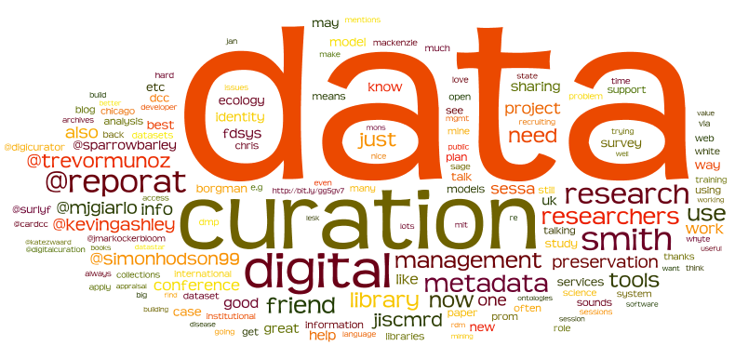
Conclusions
Data curation is an emerging field for academic libraries
Future directions need to be studied to better satisfy the information needs of researchers
Five aspects of directions:
collaboration and integration
permanent preservation
data quality framework
security and sharing
value-added information

Slide 17
Choudhury, G. S. (2008). Case study in data curation at Johns Hopkins University. Retrieved from https://www.ideals.illinois.edu/handle/2142/10669
Curry, E., Freitas, A., & O’Riáin, S. (2010). The Role of Community-Driven Data Curation for Enterprises. In D. Wood (Ed.), Linking Enterprise Data (pp. 25–47). Springer US. Retrieved from http://link.springer.com/chapter/10.1007/978-1-4419-7665-9_2
Giarlo, M. J. ., leftwing@alumni. rutgers. ed. (2013). Academic Libraries as Data Quality Hubs. Journal of Librarianship & Scholarly Communication, 1(3), 1–10. http://doi.org/10.7710/2162-3309.1059
Heidorn, P. B. (2011). The Emerging Role of Libraries in Data Curation and E-science. Journal of Library Administration, 51(7/8), 662–672. http://doi.org/10.1080/01930826.2011.601269
Higgins, S. (2008). The DCC Curation Lifecycle Model. International Journal of Digital Curation, 3(1), 134–140. http://doi.org/10.2218/ijdc.v3i1.48

